Slide 1
MATH6380P Project 2
—— Image Classification of Semiconductors
Team members:
Hao He
Yue Guo
He Cao
Haoyi Cheng

Slide 2
Contents
Background & Introduction
Dataset Description
Model
Experimental Results & Analysis

Slide 3
Background & Introduction
Problems:
Several defected ones among a large number of products
laborious & time-intensive
Image Classification with Deep Learning
High precision & Effective

Slide 4
Tasks in This Project
Dataset of 34459 images of semiconductors (labeled as good or defected)
Use this dataset to train an image classifier enabling to generalize well on the unseen data
Have a detailed Exploration Data Analysis(EDA), and report the features of the dataset
Solve the image classification task by fine-tuning the pre-trained models, and use many model refinement methods to improve the model performance
Study the results of ensemble models, and find out that ensemble models can improve the generalization
Conduct a large number of experiments, and empirically find out the best single model and best ensemble model

Slide 5
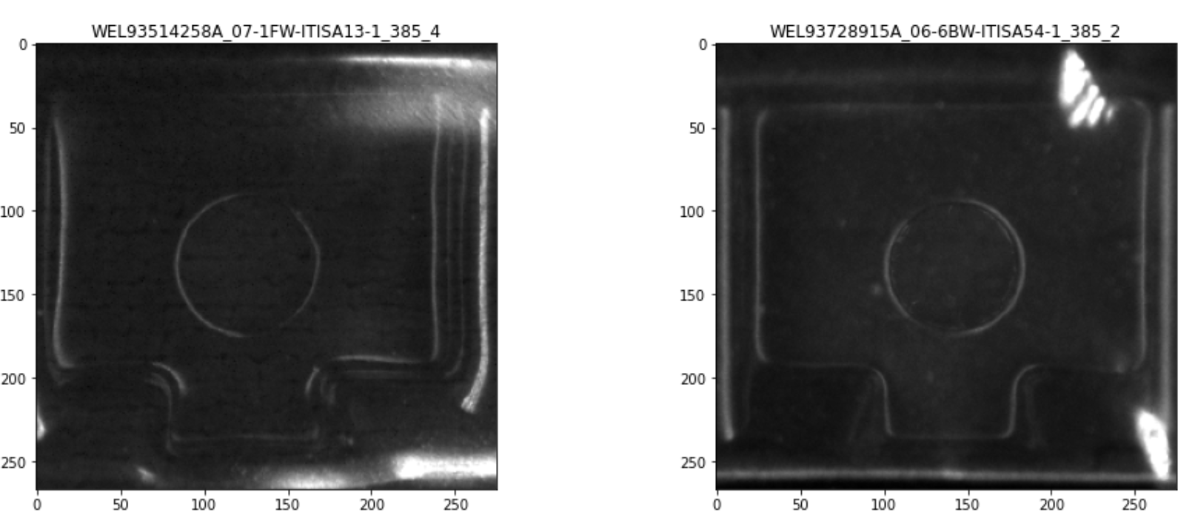
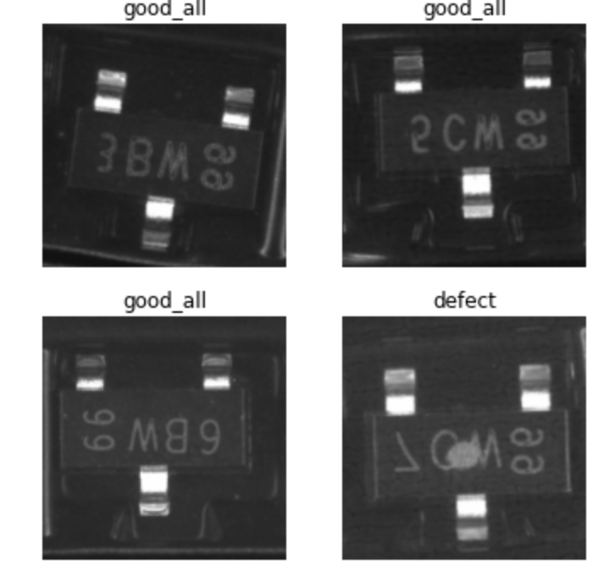
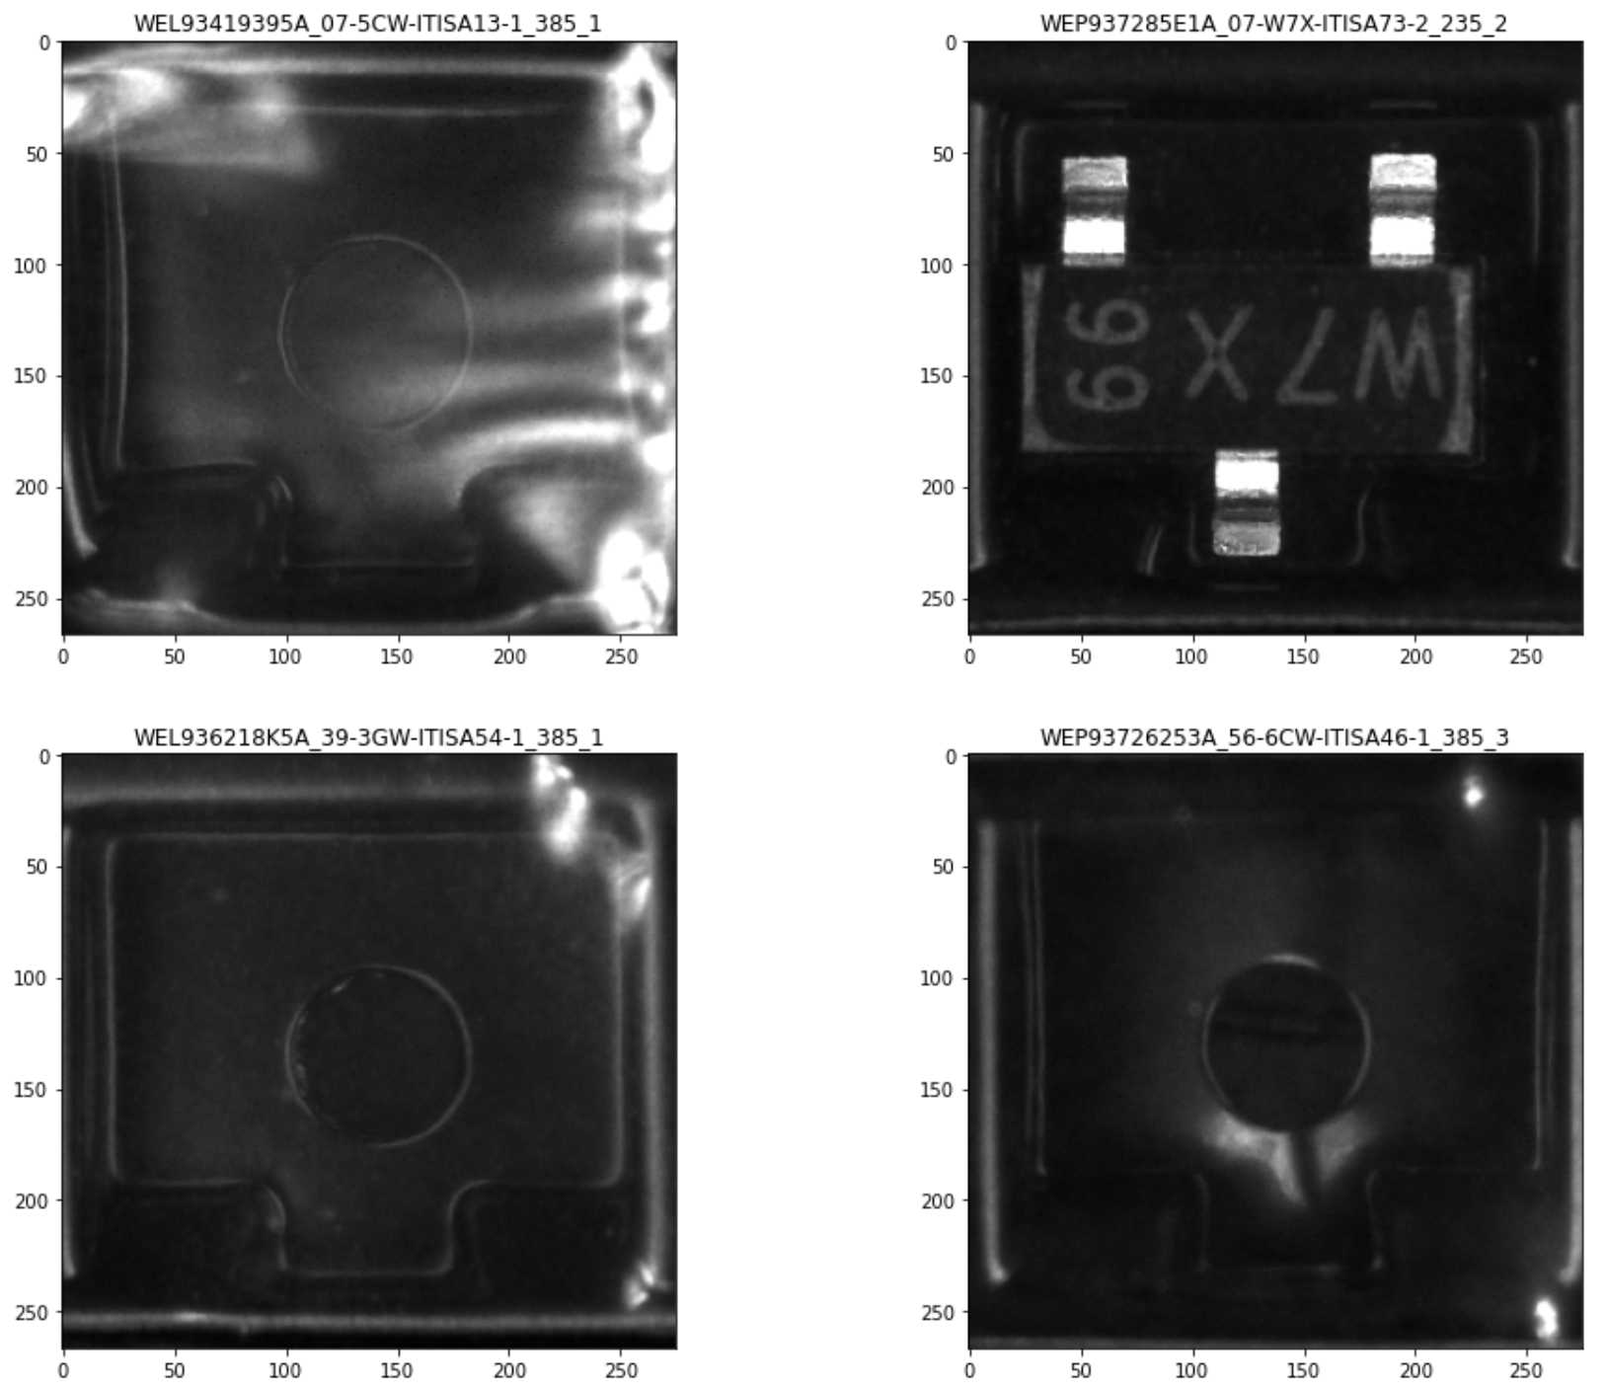
EDA: Unlabeled Data
The unlabeled defect data doesn’t look like regular semiconductor chips

Slide 6
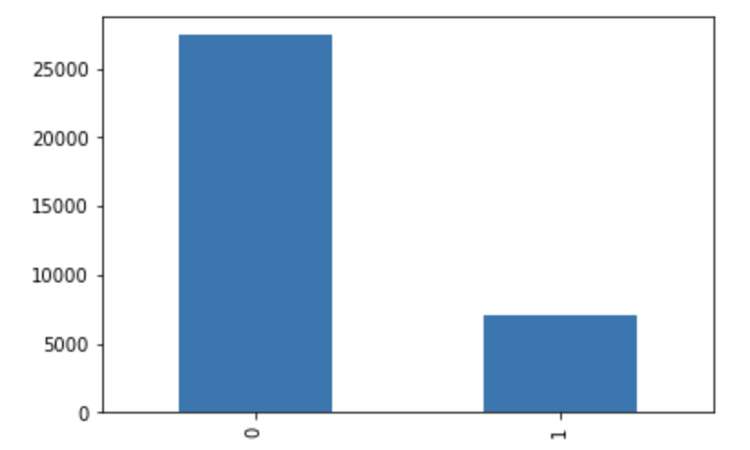
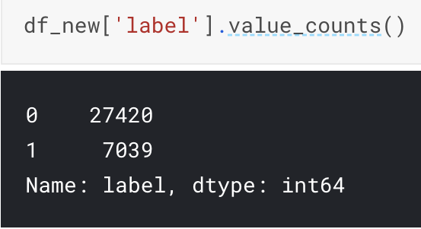
EDA: Dataset Imbalance
Good V.S. Defect is roughly 4:1

Slide 7
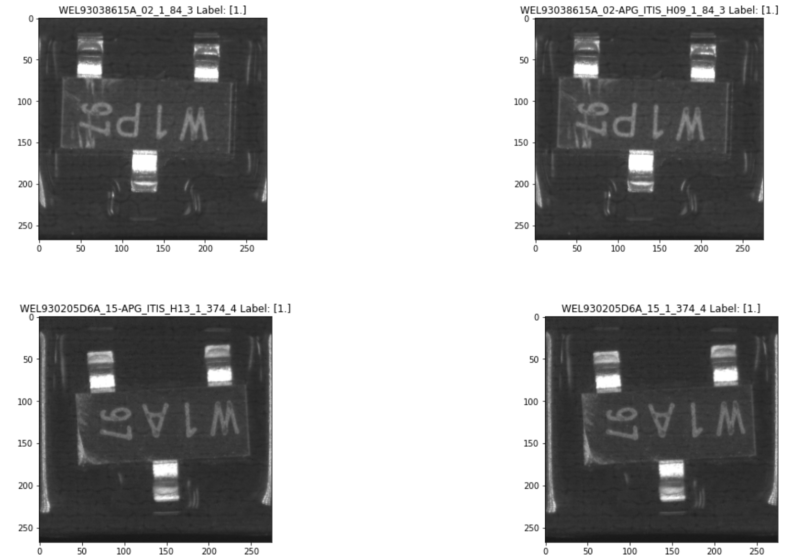
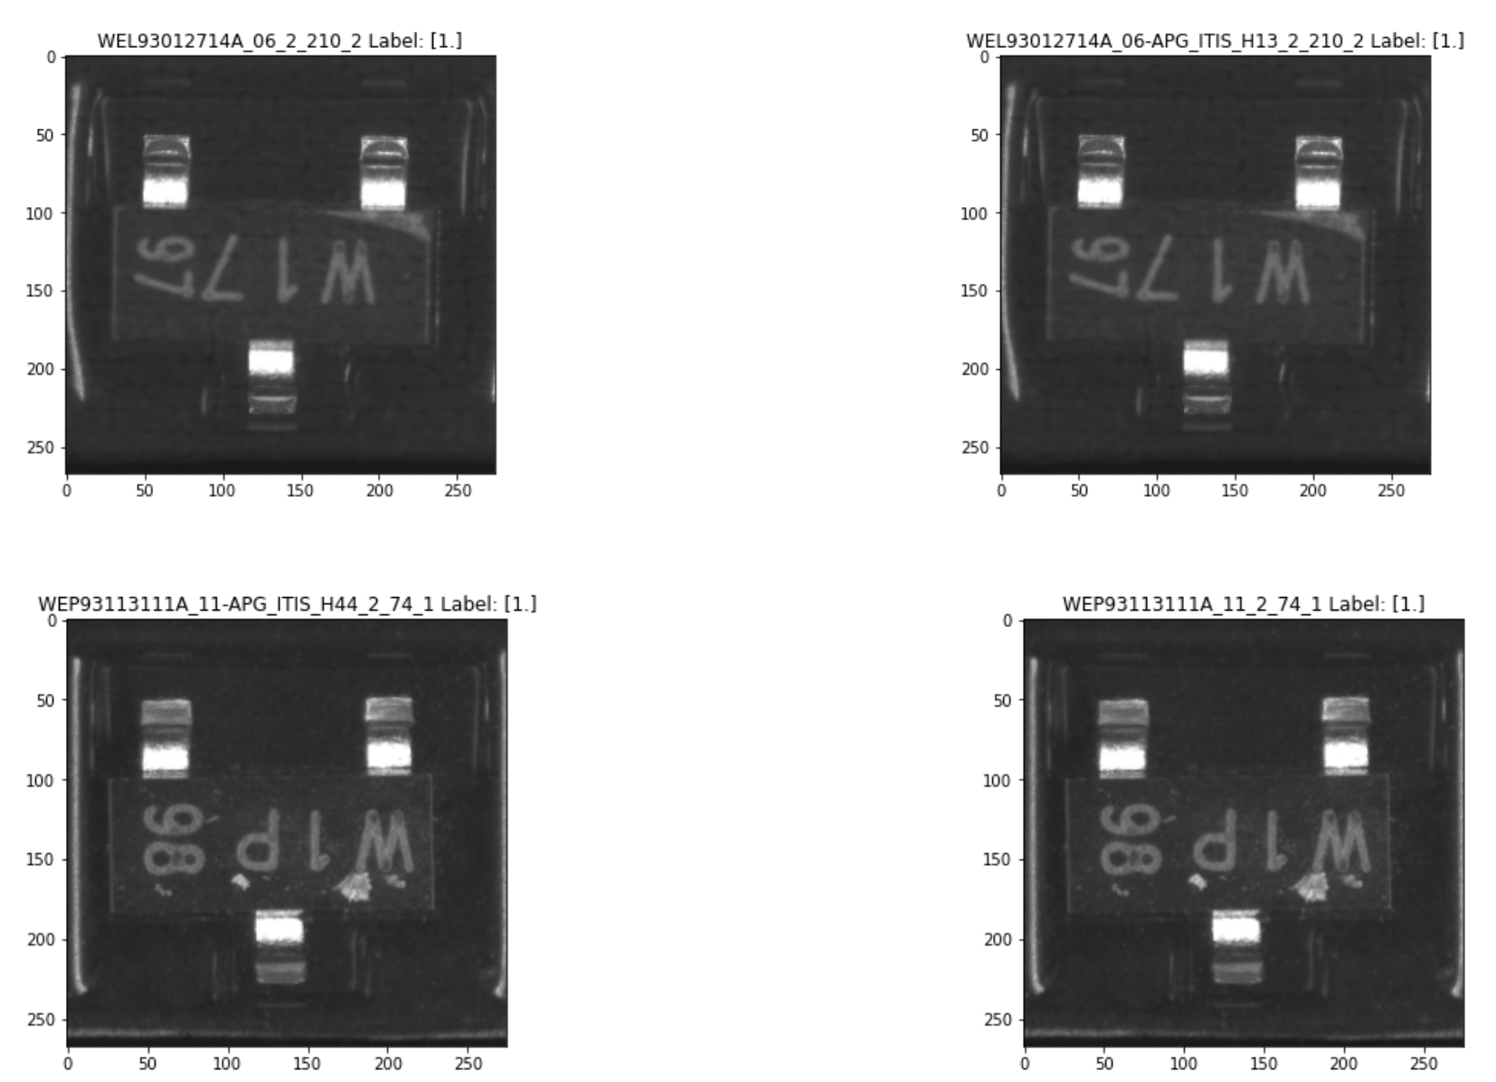
EDA: Duplicates

Slide 8
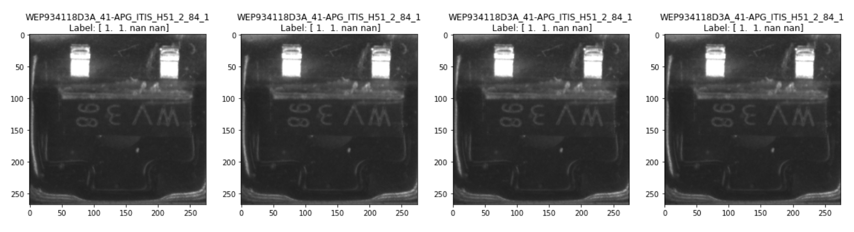
EDA: Duplicates in test set

Slide 9
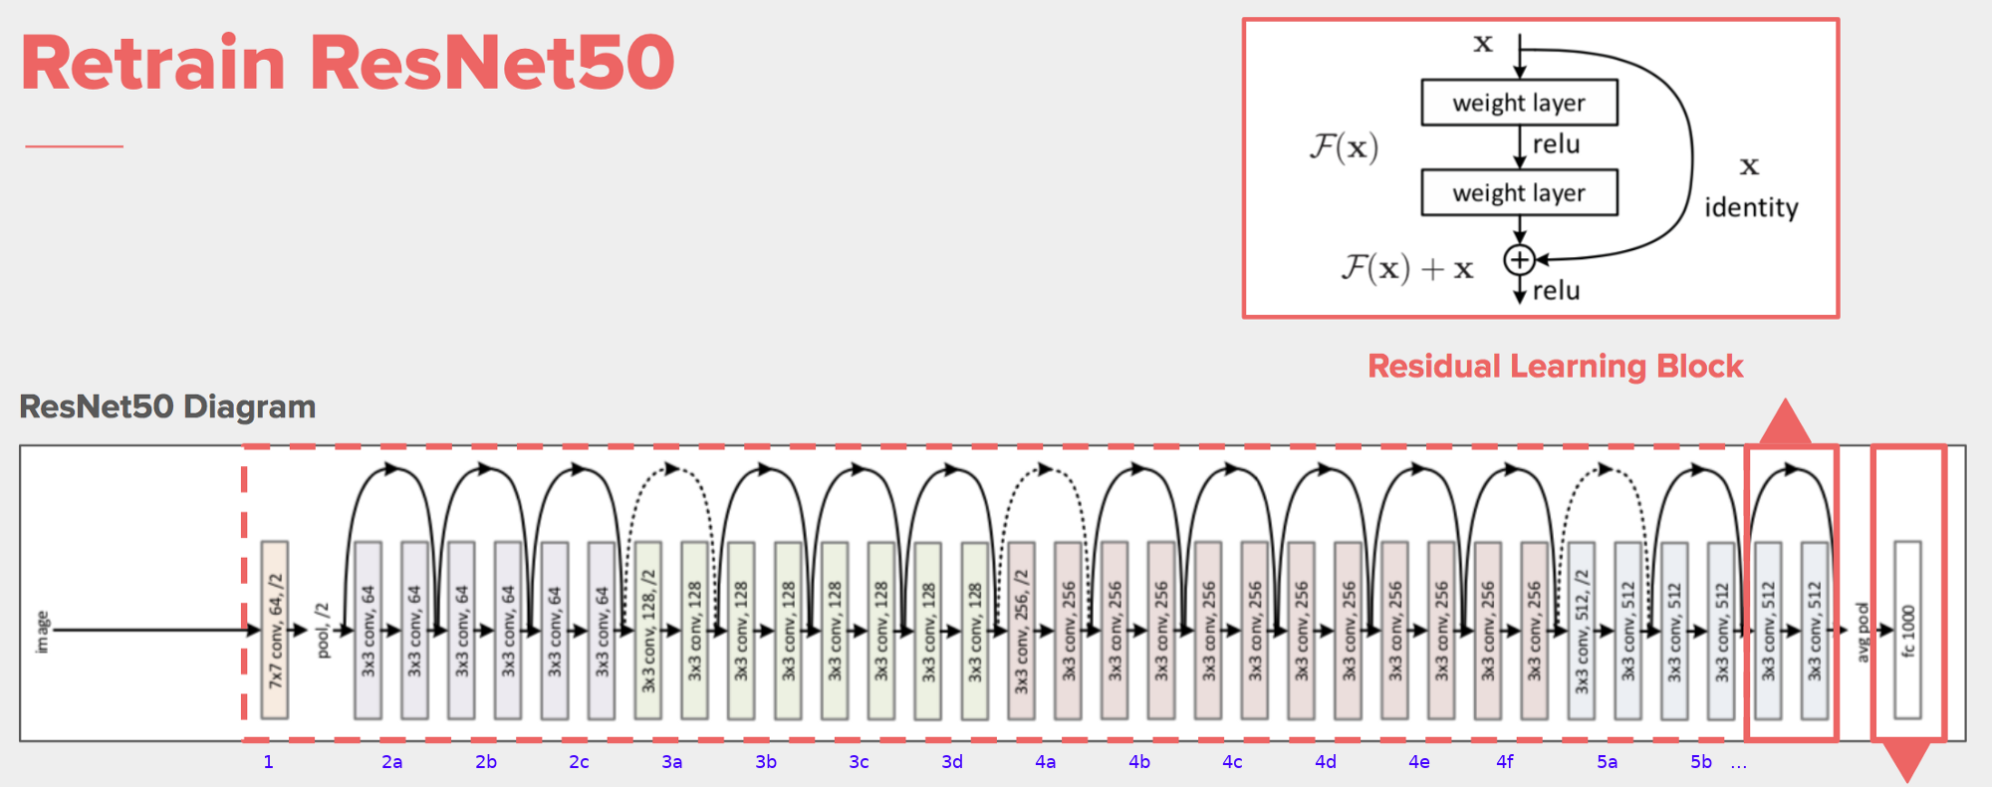
Baseline Model

Slide 10
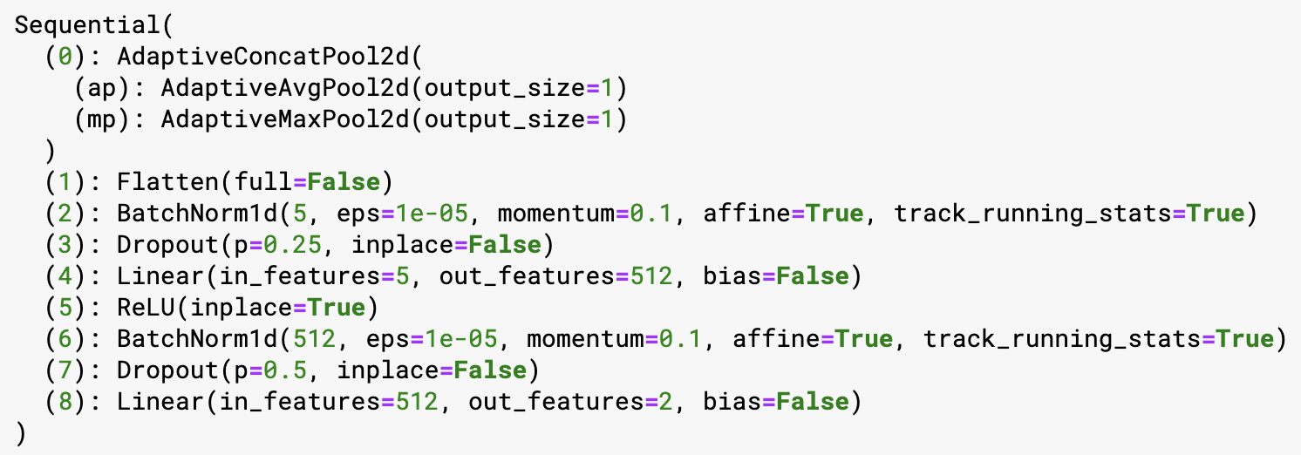
Stacked Pooling
To have 2048 * 2 features passed to downstream tasks

Slide 11
Model Refinement
Batchwise oversampling using weighted Pytorch Dataloader
Random flip vertically and horizontally
Rotating image by 10 degree
Zooming the image by 1.1
Increase image contrast and lighting by 0.2
Apply perspective warping by 0.2
Label Smoothing CrossEntropy Loss

Slide 12
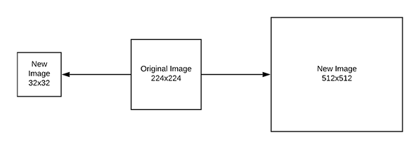
Training Refinement
To create domain specific models, reduce overfitting
Progressive Resizing

Slide 13
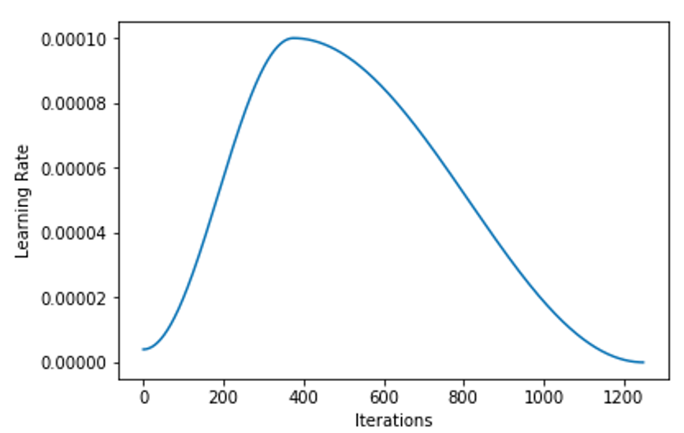
Model Refinement
Freeze Body
Fine-tuning
Two Stage Training
Cosine Learning Rate

Slide 14
Ensemble modeling:
A process where multiple diverse models are created to predict an outcome.
By using many different modeling algorithms
By using different training datasets
Aggregate the prediction of each base models and results in one final prediction for the unseen test data.
Simplest way: Average the results

Slide 15
Motivation: Reduce the generalization error of the prediction
Single NN are nonlinear and have a high variance, since it usually learns via a stochastic training algorithms
Combine multiple models will add a bias, which will be offset with the variance of the NN
The model's prediction will not be sensitive to the details of training data, the choice of training scheme and the contingency of a single training run.

Slide 16
Experiment:
Choose 5 different base models, including ResNet50, ResNet34, DenseNet121, DenseNet169,and traditional famous network AlexNet.
We trained the five models separately using same training schemes, such as setting same learning rate and fixed epoch number(5).
Then according to each network's performance on test data, we manually design different combinations and average the predictions of componential networks to make the final prediction.

Slide 17
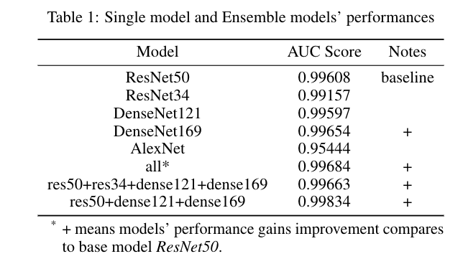
We observed that the ensemble methods can effectively reduce the variance of single model and can achieve a higher performance than any single model.
Some networks are older and have simpler structures than ResNet50, can be defined as weaker classifiers. But our ensemble experiment results still prove the ensemble methods can gain better classification accuracy than any single model.

Slide 18
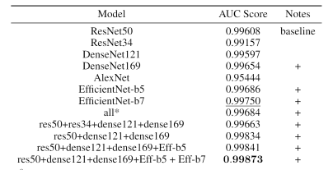
Final Result
Our baseline model (ResNet50) achieves the AUC Score of 0.99608.
Table 2. Overall Result

Slide 19
Final Result
Our baseline model (ResNet50) achieves the AUC Score of 0.99608.
The best single model is achieved by EfficientNet-b7 (AUC 0.99750).
Table 2. Overall Result

Slide 20
Final Result
Our baseline model (ResNet50) achieves the AUC Score of 0.99608.
The best single model is achieve by EfficientNet-b7 (AUC 0.99750).
The best model is the ensemble of Resnet50+DensenNet121+DenseNet169+EfficientNet-b5+EfficientNet-b7
Table 2. Overall Result

Slide 21

Final Result
This result is ranked No.1 in the learderboard at the time of this report is done!
Ranking on Dec-13-2020

Slide 22
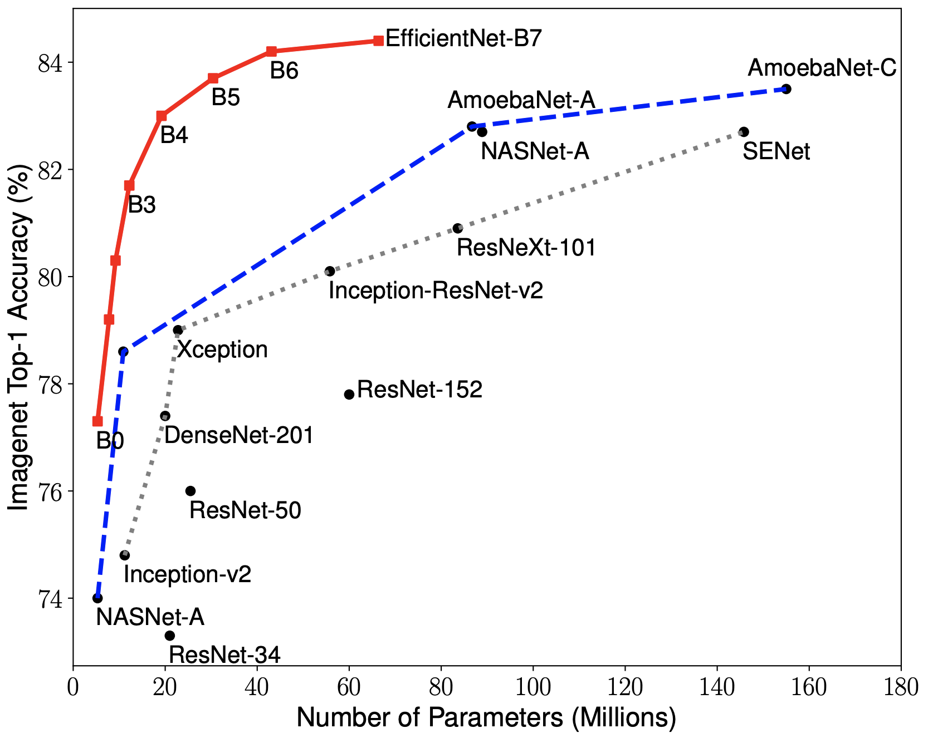
Final Result Analysis
Larger model has better performance and generalization ability.
AutoML and Compound Scaling Method (which are used in EfficientNets) can help to improve the model architecture and efficiency.
Table 2. Overall Result
Figure: #parameters-Accuracy relationship of different models

Slide 23
Final Result Analysis
Ensemble models are better than single models, because by aggregating different models, we can alleviate the problem that a single model may fall into the local minimum and overfit the training data.
Table 2. Overall Result

Slide 24
Final Result Analysis
Hyperparameters and training tricks are also crucial to the model performance.
Table 2. Overall Result

Slide 25
Conclusion
Exploration Data Analysis is useful when starting a Kaggle project.
Model refinement and training refinement methods can improve the baseline result.
Ensemble models are more powerful than single models.
Larger models are more powerful than small models.

Slide 26
Thank you for listening!

